Slide 1
Nuclear Fuel Performance
NE-533
Spring 2025

Slide 2
Housekeeping
MOOSE project due end of next week
Exam next Thursday: 2/29
Problem session next Tuesday: 2/27

Slide 3
Last Time
Dr. Jiang covered an intro to numerical thermomechanics
Fuel performance codes are focused on predicting the temperature of the pellet and the stress in the cladding
All fuel performance codes
Numerically model the temperature in the fuel
Numerically model the stress in the cladding
And consider gap pressure, closure, and heat transfer in some way
Last-Last Time:
Gap size change due to thermal expansion
Intro into defects and materials processing

Slide 4
UO2 Radiation effects

Slide 5
Radiation Damage
The macroscopic and observable results of exposure of solids to energetic particles are collectively known as radiation effects
Heat production from the nuclear fuel to generate electricity ensues mostly from the slow down of the fission products by nuclear or electronic interactions
As a direct consequence, there are also defects created along the path of the fission fragments leading to modification of the physical properties of the fuel
Most Frenkel defects (interstitial-vacancy pair) are produced by secondary collision cascades
Local charge neutrality prevents the formation of interstitials and vacancies as independent processes, as the cations and anions are charged species
In UO2, two anion vacancies need to be created for each cation vacancy, forming a Schottky trio
The dominant defect type is anion Frenkel pairs

Slide 6
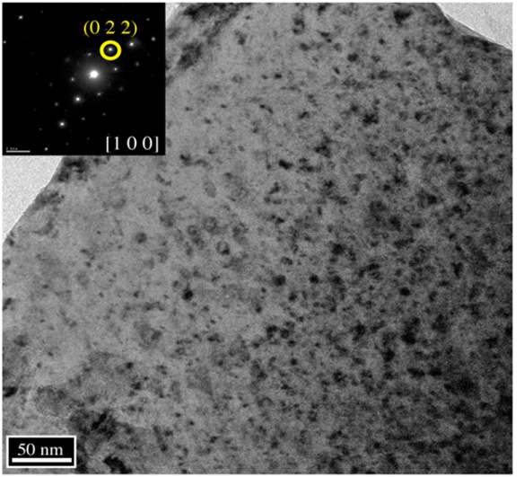
Loop Formation
Dislocations generally a mixture of screw and edge components in the shape of a loop
The most important slip system in UO2 is the one which minimizes the electrostatic energy, the easy slip along {100}<110> tends to minimize the intense repulsive force between cations
Prismatic loops are of interstitial type and consist of a disc-shaped layer of defects in a cluster
This defect cluster is more energetically favorable than dispersed defects in the bulk
Vacancy clusters will form into voids
Prismatic loops in UO2 from alpha particle irradiation

Slide 7
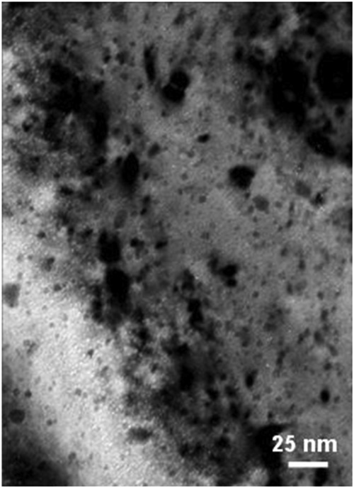
Voids
Due to preferential absorption of interstitials at dislocations, we are left with a slight excess of vacancies in the bulk to nucleate and grow voids
Void nucleation can occur homogeneously by the collection of vacancies in the matrix, or heterogeneously at structural features (precipitates, grain boundaries, etc.)
The vacancy-rich radiation damage core is considered to be an important void nucleation mechanism in UO2
Vacancy diffusion then allows void growth
Gas atoms can often serve to stabilize small voids
Voids (bright spots) from alpha irradiation in UO2

Slide 8
Radiation Effects
Chemistry changes
two fission products are generated from each fission, resulting up to about 3% of the chemical species present at the end of life for commercial fuel
the amount of fission products change both chemical and physical properties
Physical property changes
The physical effects caused by atomic displacements are rather complex and depend on the relative sink strengths of a given material for interstitials and vacancies and on the temperature
lattice parameter, thermal conductivity, elasticity, formation of the high burnup structure

Slide 9
Thermal Conductivity Degradation
One of the major effects of defect formation is the degradation of thermal diffusivity, due to phonon scattering
Results obtained on irradiated UO2 show that the thermal conductivity is decreasing with increasing burn-up, and that at equal burn-up, samples with higher irradiation temperatures have higher thermal conductivity
There are mesoscopic and atomistic features that affect the thermal conductivity
The porosity existing in fresh fuels evolves during irradiation and has a strong impact on heat transport, because voids/bubbles have significantly lower kth than the lattice
Precipitates are formed by fission products that are insoluble in the UO2 lattice, forming oxide or metallic inclusions: can use composite theory to get effective thermal conductivities; typically, these precipitates INCREASE the thermal conductivity of the fuel

Slide 10
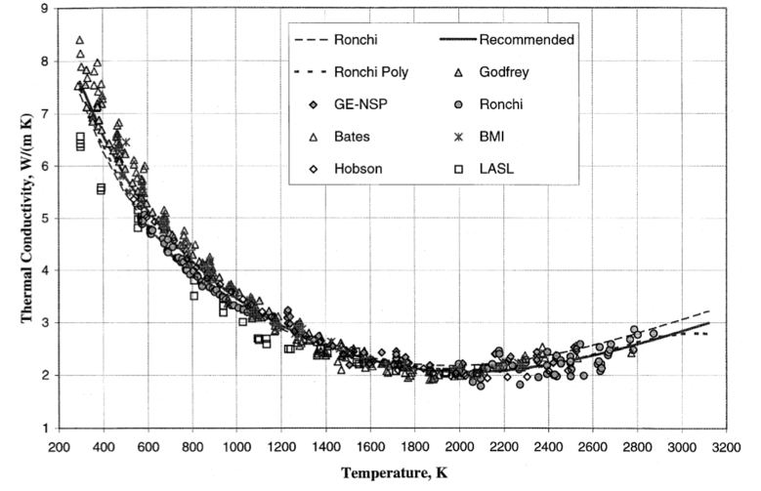
Thermal Conductivity Degradation
Actinides, rare earths, and transition metals can form mixed oxides with UO2 (soluble fission products): these atoms act as phonon scattering centers as a result of the differences in bonding, radii, or mass, and thus decrease kth
Volatile fission products/gases are partially in solution and partially in bubbles, where they act as phonon scatterers or as low kth composite fractions
Point defects and extended defects contribute to the degradation of the thermal conductivity by scattering or limiting the mean free path of the phonons

Slide 11
UO2 Thermal Conductivity
We have established correlations for thermal conductivity of fresh UO2 fuel as a function of temperature
Where t = T/1000
The first part of the equation describes the phonon interactions
The second part describes electronic transport which becomes significant at high temperature

Slide 12
UO2 Thermal Conductivity
UO₂ thermal conductivity is low and decreases more during reactor operation
The thermal conductivity has been collected after various amounts of burnup to make empirical fits

Slide 13
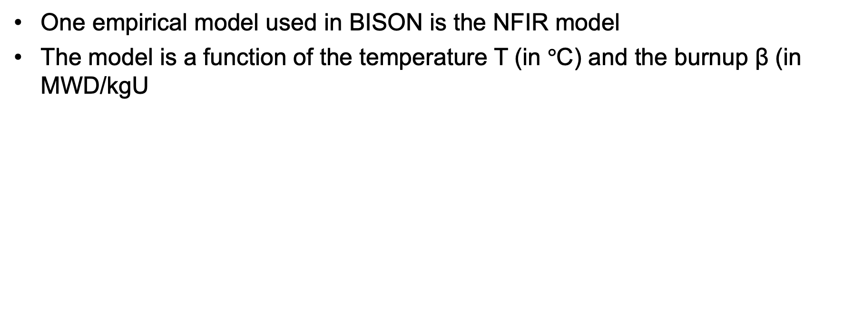
UO2 Thermal Conductivity
One empirical model used in BISON is the NFIR model
The model is a function of the temperature T (in $°$C) and the burnup β (in MWD/kgU

Slide 14
UO2 Thermal Conductivity
The R_{f} function switches between two k_{ph} functions, accounting for thermal recovery

Slide 15
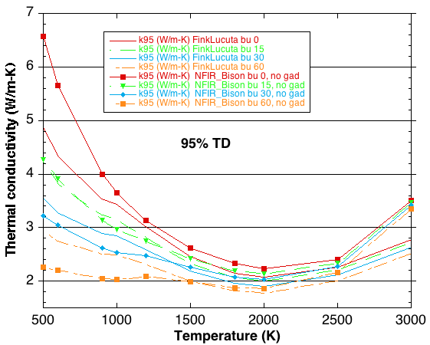
MOOSE/BISON Models
https://mooseframework.inl.gov/bison/source/materials/UO2Thermal.html
Fink-Lucuta
Halden
NFIR
NFI
Ronchi-Staicu
Toptan (NCSU alum)

Slide 16
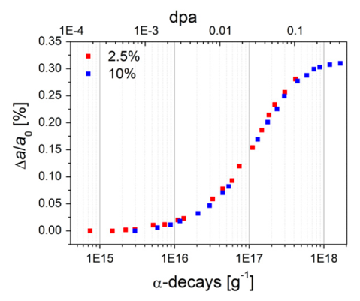
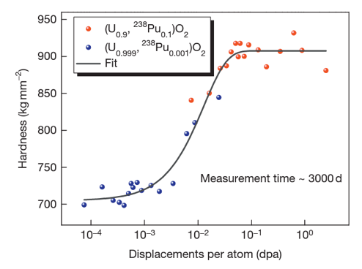
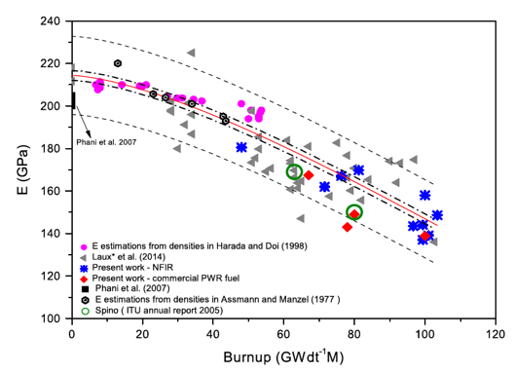
Other Physical Changes
An important effect of radiation damage is the volume increase of the crystal lattice, leading to macroscopic swelling of the fuel material
Alpha particle damage alone can cause approximately 0.4% swelling
Mechanical properties also vary with damage
Hardness increases as a function of dpa
Young’s modulus decreases with dpa

Slide 17
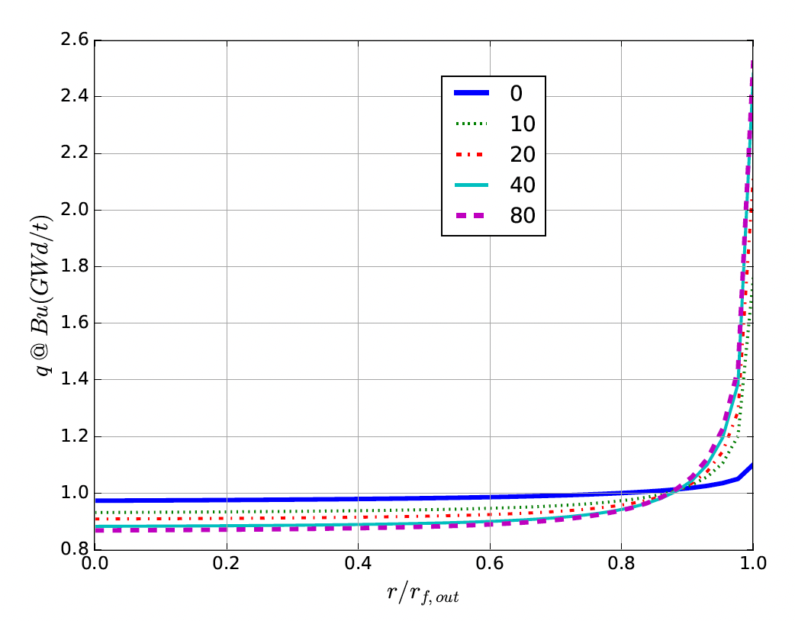
High Burnup Structure (HBS)
At the beginning of the irradiation, the local power is ~10% higher on the pellet periphery, due to self-shielding effect in 235U fissions driven by neutrons entering the rods after interactions in the water
With increasing burnup, a strong capture of neutrons by U-238 in the resonance range occurs at the periphery of the fuel
This leads to the production of Pu-239, and leads to a higher fissile density and thus a further increase in the local power/burnup
This high local burnup area is on the outer ring of the fuel and is about 200 microns thick, which represents about 8% of the fuel

Slide 18
High Burnup Structure (HBS)
When thermal recovery is not sufficiently efficient (at lower temperatures), the accumulation of defects at high burnup can lead to the instability of the crystalline structure, initiating a restructuring driven by the energy stored in the material
This can be amorphization (not observed in UO2) or recrystallization/polygonization
Polygonization is the rearrangement of dislocations into sub-domain walls with slightly misaligned grains
In UO2, grains subdivide from 10 microns in size to 100-200 nm size, and a densely porous structure is formed (~20% porosity)

Slide 19
High Burnup Structure (HBS)
The increase of the relative porosity volume degrades the material conductivity and reduces the mean grain size
On the other hand, the intragranular irradiation defect-cleaning improves the fuel intrinsic thermal conductivity
Fission gas in HBS bubble is retained, not released
Exact mechanism of HBS formation is not fully understood, believe to be polygonization, interacting with fission gas bubbles, dislocation growth, and high levels of energy deposition

Slide 20
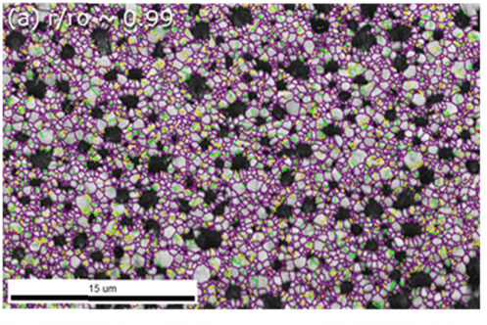
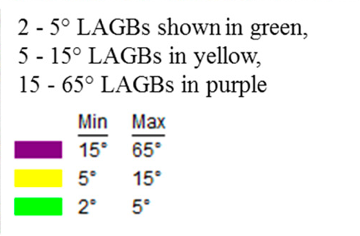
High Burnup Structure (HBS)
HBS has a high fission gas retention capacity, and does not evolve toward an open system of interconnected channels, even when porosity reaches very high values
Thus, the HBS is a relatively stable structure, limiting pressure increase in the plenum
While burnup is higher in the rim region, the HBS polygonization removes/sweeps defects to new grain boundaries, removing some phonon scatterers
Despite high porosity, thermal conductivity increases, slightly decreasing centerline temperatures in high burnup fuel

Slide 21
Radiation Effects Summary
Formation of loops of voids as primary defect clusters
Radiation effects include both chemistry and physical property changes
One of the key physical properties modified is the thermal conductivity
have several empirical (and mechanistic) models to account for burnup and temperature
HBS forms towards the end of life, generating a fine-grained structure with high porosity
HBS retains fission gas and slightly increases thermal conductivity

